Slide 1
Bakery Sales Prediction and Effects of Corona Virus

Slide 2
Team Member
Saad Naeem Malik
Shahwar Zia

Slide 3
Tools and Language
Git
Jupyter Notebook
Tensor Flow
Python and Its libraries

Slide 4
Our Aim
Goal of our project was to make accurate prediction of bakery sales based on the historical data.
Projected effects on sales based with respect to corona virus.

Slide 5
How we do it?
Data:
We received data for 6 different product groups and their respective turnovers.
spanned over 5 years. (2015 - 2020)
We additionally downloaded the Corona virus data from ourworldindata.org to compare the trend with the rise of new cases of corona

Slide 6
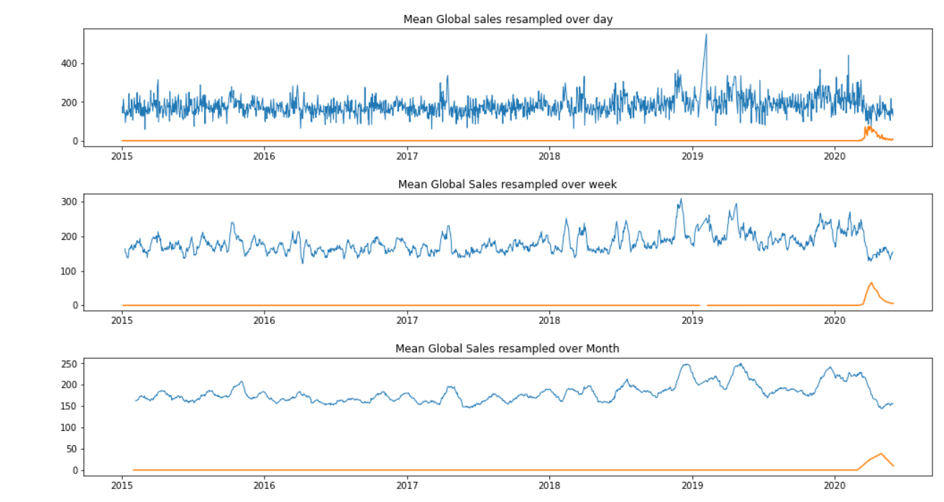
How we do it?
Correlation between COVID and Bakery data for product group 1:

Slide 7
How we do it?
Clean Data
To work with the data we used the pandas library
We separated the product groups into 6 different data sets.
Then for each dataset we turned it into windowed data, where the 14th day was the label for its previous 13 days.

Slide 8
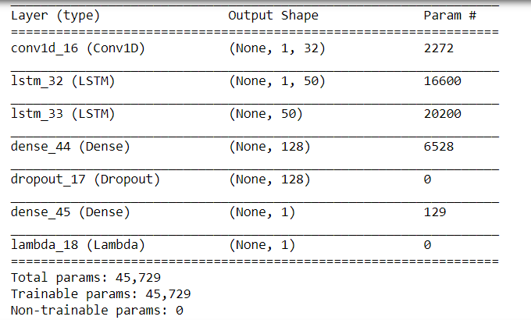
Our Model
Following was the model we used:

Slide 9
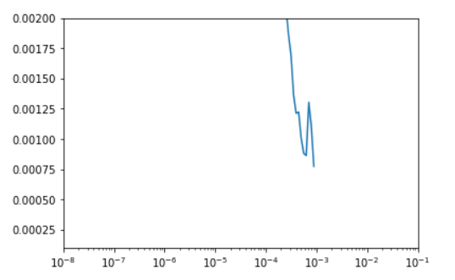
Our Model
We used callbacks to optimize our learning rate for the model.
Even though the optimal learning rate was 1e-3, it didn’t yield the best results. But it gave us a good starting point.
We settled on 1e-5 as the best learning rate.

Slide 10

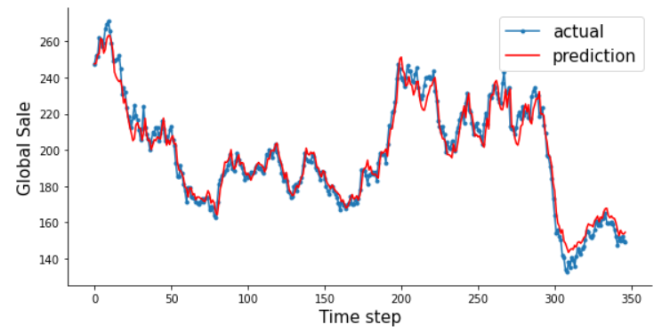
Results and Graph
We trained the model initially for the first product group. And then tested the same model for other product groups and the following was our output:
Product group 1:

Slide 11
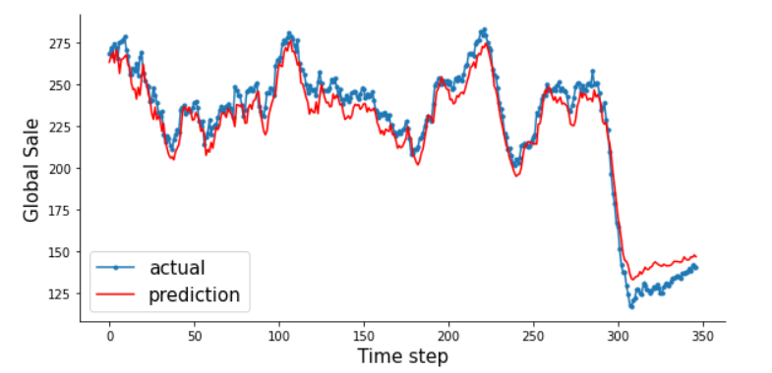
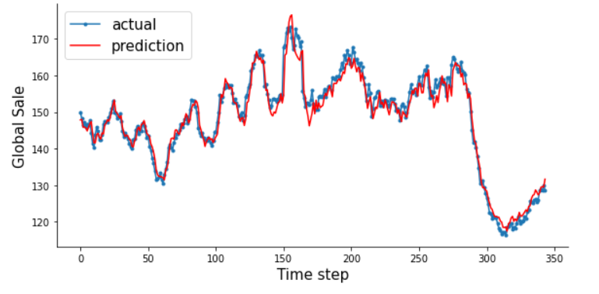
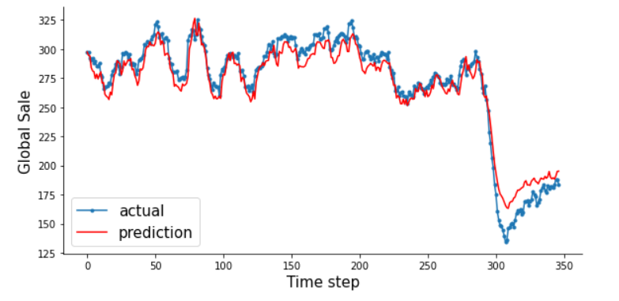
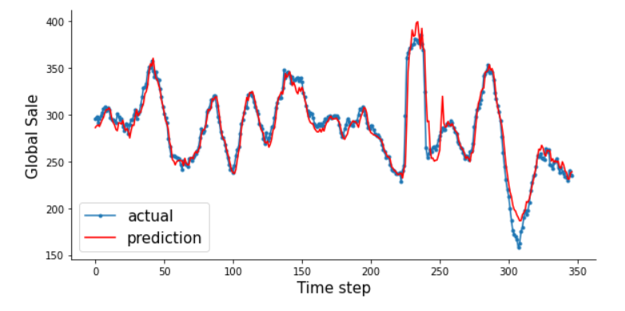
Results and Graph
Product group 2:
Product Group 3
Product group 4:
Product Group 5:

Slide 12
Results and Graph
Since the results weren’t perfect for each group with the model trained for the first group we trained a model for each group.

Slide 13
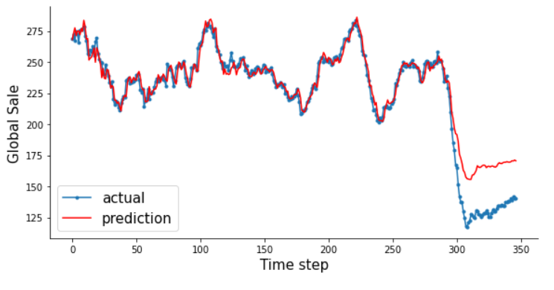
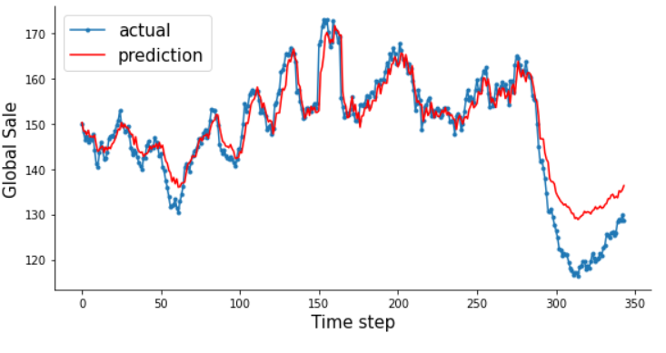
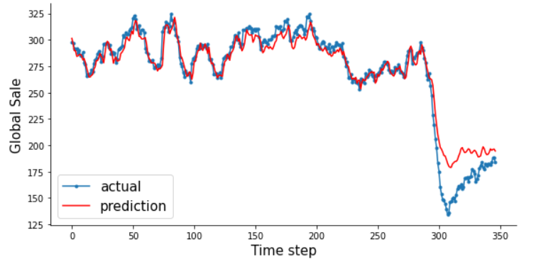
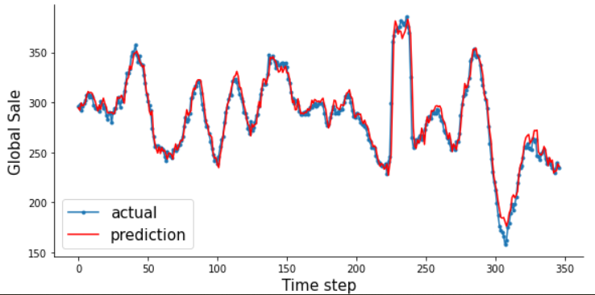
Results and Graph
Product group 2:
Product Group 3
Product group 4:
Product Group 5:

Slide 14
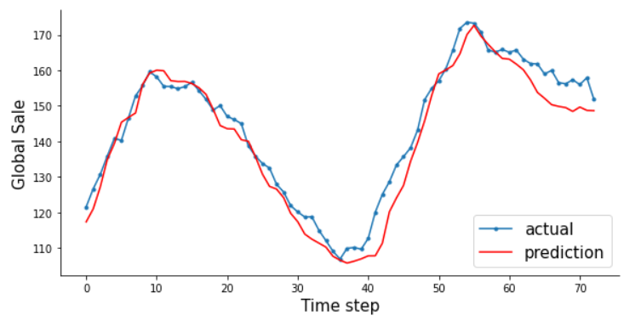
Results and Graph
Product group 6:

Slide 15
Furthermore
In future we can add web interface and application on top of it.
We can implement model for real time prediction.

Slide 16
Thank You!

